Slide 1
WELCOME TO OUR ONLINE CLASS
LETS MAKE THIS PANDEMIC SITUATION AN OPPORTUNITY FOR OUR OVERALL DEVELOPMENT WITH THE HELP OF BOTH OF THE SIDES.
SO, LETS START OUR CLASS

Slide 2
COMPUTER ARCHITECTURE
Shammi uap,cse

Slide 3
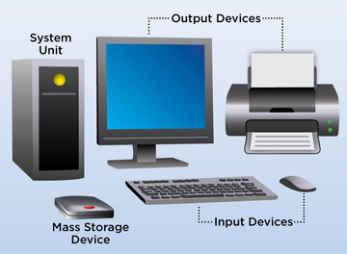
What is computer?
???

Slide 4
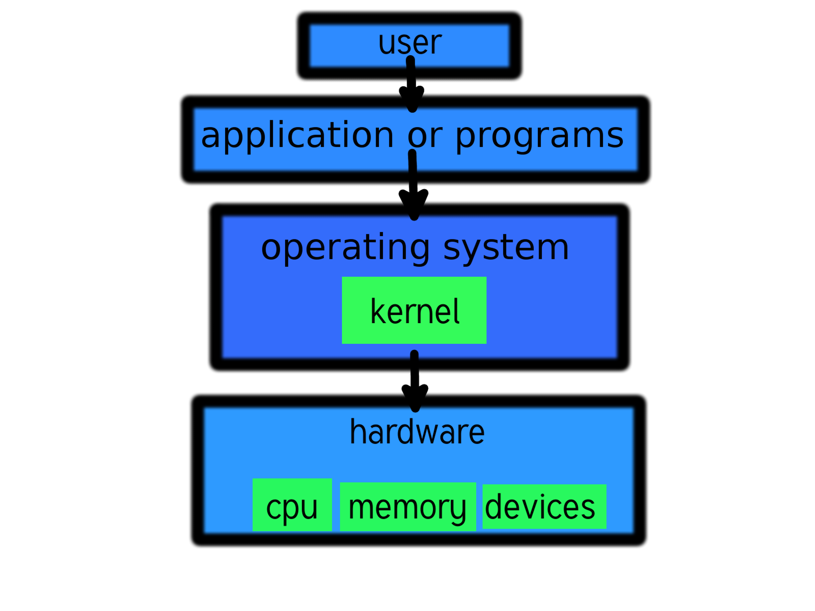

Slide 5
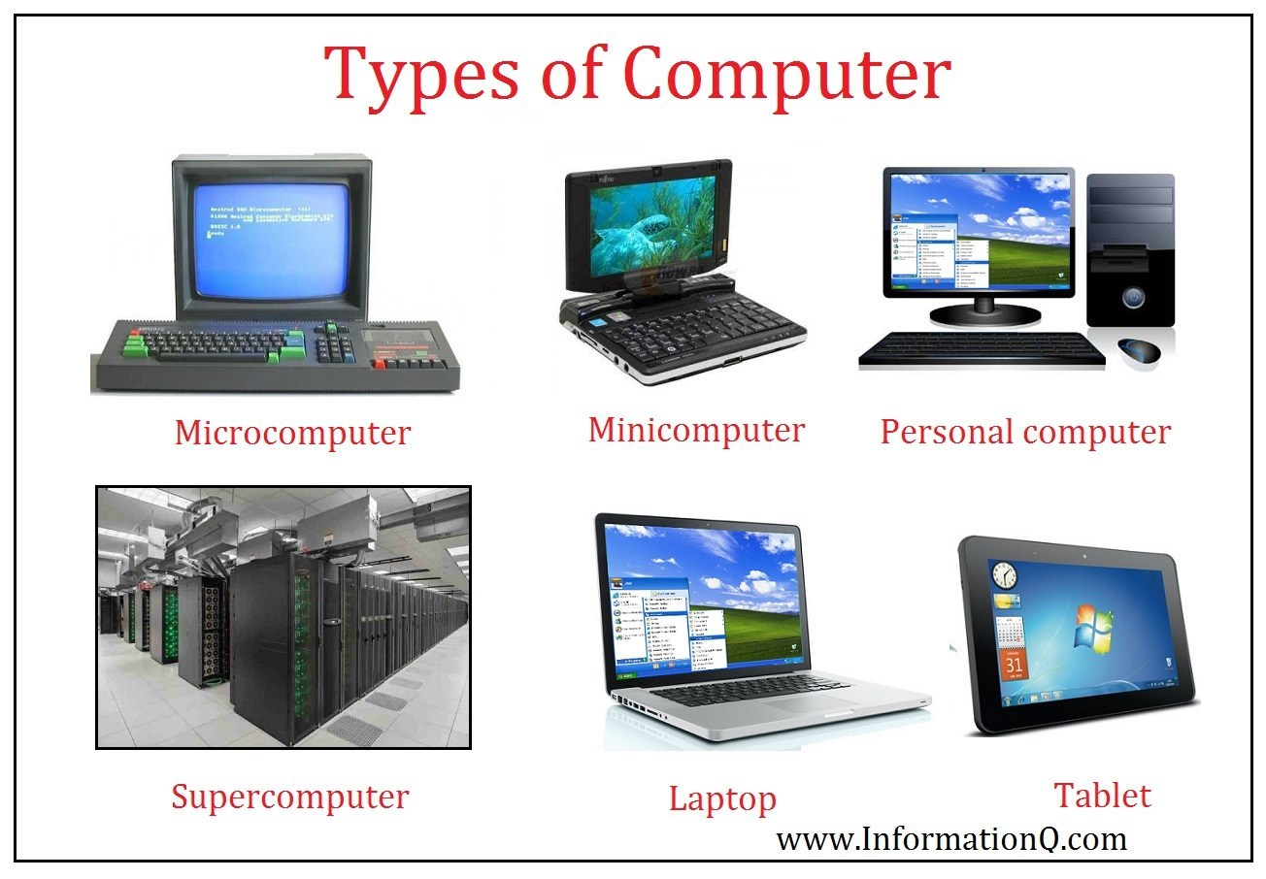
What is computer?

Slide 6
The Five Classic Components of a Computer
Input (mouse, keyboard, …)
Output (display, printer, …)
Memory
main (DRAM), cache (SRAM)
secondary (disk,
CD, DVD, …)
Datapath
Control
Input
Output
Processor
(CPU)
Processor
Control
Memory
1001010010110000
0010100101010001
Datapath
1111011101100110
1001010010110000
1001010010110000
1001010010110000

Slide 7
Question/answer

Slide 8
Introduction
Rapidly changing field:
vacuum tube -> transistor -> IC -> VLSI
doubling every 1.5 years:
memory capacity
processor speed (due to advances in technology and hardware organization)
Things we’ll be learning:
how computers work, what’s a good design and what’s not
how to make them – yes, we will actually build working computers!!
issues affecting modern processors (e.g., caches, pipelines)

Slide 9
Our Primary Focus
The processor (CPU)…
datapath
control
…implemented using millions of transistors
…impossible to understand by looking at individual transistors
we need...

Slide 10
What is “Computer Architecture”
Computer Architecture =
Instruction Set Architecture +
Machine Organization

Slide 11
Instruction Set Architecture (subset of Computer Arch.)
... the attributes of a [computing] system as seen by the programmer, i.e. the conceptual structure and functional behavior, as distinct from the organization of the data flows and controls the logic design, and the physical implementation. – Amdahl, Blaaw, and Brooks, 1964
SOFTWARE
-- Organization of Programmable
Storage
-- Data Types & Data Structures:
Encodings & Representations
-- Instruction Set
-- Instruction Formats
-- Modes of Addressing and Accessing Data Items and Instructions
-- Exceptional Conditions

Slide 12
The Instruction Set: a Critical Interface
software
instruction set
hardware

Slide 13
Instruction Set Architecture
A very important abstraction:
interface between hardware and low-level software
standardizes instructions, machine language bit patterns, etc.
advantage: allows different implementations of the same architecture
disadvantage: sometimes prevents adding new innovations
Modern instruction set architectures:
80x86/Pentium/K6, PowerPC, DEC Alpha, MIPS, SPARC, HP

Slide 14
What is Computer Architecture? Easy Answer
Computer Architecture =
Instruction Set Architecture +
Machine Organization

Slide 15
What is “Computer Architecture”?
Application
Operating
System
Compiler
Firmware
Instruction Set
Architecture
Instr. Set Proc.
I/O system
Datapath & Control
Digital Design
Circuit Design
Layout
Coordination of many levels of abstraction (mainly within the oval; NOTE: Arithmetic ckts fall into both architecture and digital design).
Under a rapidly changing set of forces
Design, Measurement, and Evaluation

Slide 16
Organization
Capabilities & Performance Characteristics of Principal Functional Units (FUs)
(e.g., Registers, ALU, Shifters, Logic Units, ...)
Advanced design and analysis of FUs for opt. (speed, power)
Ways in which these components are interconnected
Information flows between components
Logic and means by which such information flow is controlled.
Choreography of FUs to realize the ISA
Register Transfer Level (RTL) Description
Logic Designer's View
ISA Level
FUs & Interconnect
Notes:
Design state of art organization in 1990

Slide 17
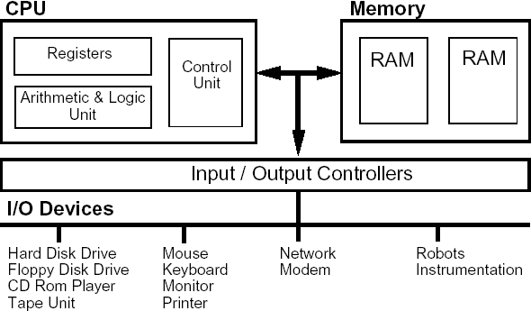
#introduction to computer architecture

Slide 18
Forces on Computer Architecture
Technology
Programming
Languages
Applications
Computer
Architecture
Operating
Systems
History
Notes:
History/Applications matters because
1) People buy computers to run programs
2) Most people don;’t write own programs
3) Documented IDA interface means people ship binary machine code

Slide 19
Introduction to Computer Architecture. A general-purpose computer has these parts: 1. Processor: The ‘brain’ that does arithmetic, responds to incoming information, and generates outgoing information. 2. Primary storage (memory or RAM): The ‘scratchpad’’ that remembers information that can be used by the processor. 3. Input and Output unit: I/O Organization The Input / output organization of computer depends upon the size of computer and the peripherals connected to it. The I/O Subsystem of the computer, provides an efficient mode of communication between the central system and the outside environment.

Slide 20
Measurement and Evaluation
Architecture is an iterative process
-- searching the space of possible designs
-- at all levels of computer systems
Design
Analysis
Creativity
Cost /
Performance
Analysis
Good Ideas
Mediocre Ideas
Bad Ideas

Slide 21
Why do Computer Architecture?
CHANGE
It’s exciting!
It has never been more exciting!
It impacts every other aspect of electrical engineering and computer science

Slide 22
Course Content
Computer Architecture
-Instruction Set -Computer Organization
-Hardware Components (Basic & Adv.)
-Hierarchy of Components -Interfaces bet. Components
-Data and Control Flow
-Logic Designer’s View (FSM, Arithmetic Ckts, Impl.)
­ “Building Architect” & “Construction Engineer”

Slide 23
So what's in it for me?
In-depth understanding of the inner-workings of modern computers, their evolution, and trade-offs present at the hardware/software boundary.
Insight into fast/slow operations that are easy/hard to implementation hardware
Experience with the design process in the context of a large complex (hardware) design.
Functional Spec --> Control & Datapath --> Physical implementation
Yes, i think that computer architecture is important. Because of,In-depth understanding of the inner-workings of modern computers, their evolution, and trade-offs present at the hardware/software boundary. Experience with the design process in the context of a large complex (hardware) design.
Notes:
We will take a break and talk about class philosophy.

Slide 24
What you should know from prereqs?
Read and write basic C programs
Read and write in an assembly language
Logic design
logical equations, schematic diagrams, FSMs, components

Slide 25
Levels of Representation
temp = v[k];
v[k] = v[k+1];
v[k+1] = temp;
High Level Language Program
Compiler
Assembly Language Program
lw $15, 0($2)
lw $16, 4($2)
sw $16, 0($2)
sw $15, 4($2)
Assembler
Machine Language Program
0000 1001 1100 0110 1010 1111 0101 1000
1010 1111 0101 1000 0000 1001 1100 0110
1100 0110 1010 1111 0101 1000 0000 1001
0101 1000 0000 1001 1100 0110 1010 1111
Machine Interpretation
Control Signal Specification
ALUOP[0:3] <= InstReg[9:11] & MASK
°
°

Slide 26
Levels of Organization
Computer
Workstation Design Target:
25% of cost on Processor
25% of cost on Memory
(minimum memory size)
Rest on I/O devices,
power supplies, box
Processor
Memory
Devices
Control
Input
Datapath
Output
Notes:
That is, any computer, no matter how primitive or advance, can be divided into five parts:
1. The input devices bring the data from the outside world into the computer.
2. These data are kept in the computer’s memory until ...
3. The datapath request and process them.
4. The operation of the datapath is controlled by the computer’s controller.
All the work done by the computer will NOT do us any good unless we can get the data back to the outside world.
5. Getting the data back to the outside world is the job of the output devices.
The most COMMON way to connect these 5 components together is to use a network of busses.

Slide 27
Execution Cycle
Instruction
Fetch
Obtain instruction from program storage
Instruction
Decode
Determine required actions and instruction size
Operand
Fetch
Locate and obtain operand data
Execute
Compute result value or status
Result
Store
Deposit results in storage for later use
Next
Instruction
Determine successor instruction; can generally be combined w/ Decode

Slide 28
End of today's CLASS
HAVE A NICE DAY!

